Slide 1
CSE 470 : Software Engineering

Slide 2
Marks Distribution
Attendance : 0 (70% Mandatory as per policy)
Quiz: 15 (4 Quizzes, N-1 will be considered)
Assignments: 5 (Average of two assignments)
Mid Term Exam : 25
Project: 20
Final Exam : 35
Reference Books
‹#›
1. Ian Sommerville, "Software Engineering", Addison Wesley, 8th edition, 2007.
2. Roger S Pressman, Roger Pressman,"Software Engineering: A Practitioner's Approach", McGraw-Hill, 7th edition, 2010.
3. Clean Code: A Handbook of Agile Software Craftsmanship, Robert C. Martin, 2017

Slide 3
Ground Rules
Makeup MID and FINAL will be conducted as BRACU policy.
Makeup Quiz as per valid reasoning with documents
Assignment/ Report Submission needs to be submitted by given deadline.
Disciplinary action will be taken in case of Cheating.
You need to maintain class behavior.
You are encouraged to ask questions in class.
You can reach me by phone, email etc. in case of important (valid and logical) query.
Visit me in my consultation hour (available in tsr) for any query, discussion or even for gossiping.

Slide 4
Goals of Software Engineering
To produce software that is absolutely correct.
To produce software with minimum effort.
To produce software at the lowest possible cost.
To produce software in the least possible time.
To produce software that is easily maintained and modified.
To maximize the profitability of the software production effort.
In practice, none of these ideal goals is completely achievable. The challenge of software engineering is to see how close we can get to achieving these goals.
The art of software engineering is balancing these goals for a particular project.

Slide 5
Real-life Software
Inevitably most software systems are LARGE Systems.
This means:
Many people involved in design, building and testing,
Team effort, not individual effort
Many millions of $ spent on design and implementation
Millions of lines of source code
Lifetime measured in years or decades
Continuing modification and maintenance

Slide 6
Example — Eclipse
Eclipse is a popular software development environment for Java.
Some interesting characteristics of a recent release:
Lines of source code > 1,350,000.
Effort(person-years) > 400.
Classes 17,456.
Inheritance relations 15,187.
Methods 124,359.
Object instantiations 43,923.
Fields 48,441.
Call relations 1,066,838.
Lifetime bugs > 40,000.
Est. Development cost > $ 54,000,000.

Slide 7
Why Is Software Engineering Important
Cost of getting software wrong is often terrible.
Bankruptcy of software producer.
Injury or loss of human life broken software can KILL people.
Software producer profitability depends on producing software efficiently and minimizing maintenance effort. Software reuse is an economic necessity.
Immense body of old software (legacy code or dusty decks) that must be rebuilt or redesigned to be usable on modern computer systems.
Very, very few contemporary systems work correctly when first installed. We need to do much better.
Over $600,000,000,000 spent each year on producing software.

Slide 8
Software Horror Stories
Bank of America spent $23,000,000 on a 5-year project to develop a new accounting system. Spent over $60,000,000 trying to make new system work, finally abandoned it. Loss of business estimated in excess of $1,000,000,000.
The B1 bomber required an additional $1,000,000,000 to improve its air defense software, but the software still isn’t working to specification.
Ariane 5, flight 501.
The loss of a $500,000,000 spacecraft was ultimately attributed to errors in requirements, specifications and inadequate software reuse practices.

Slide 9
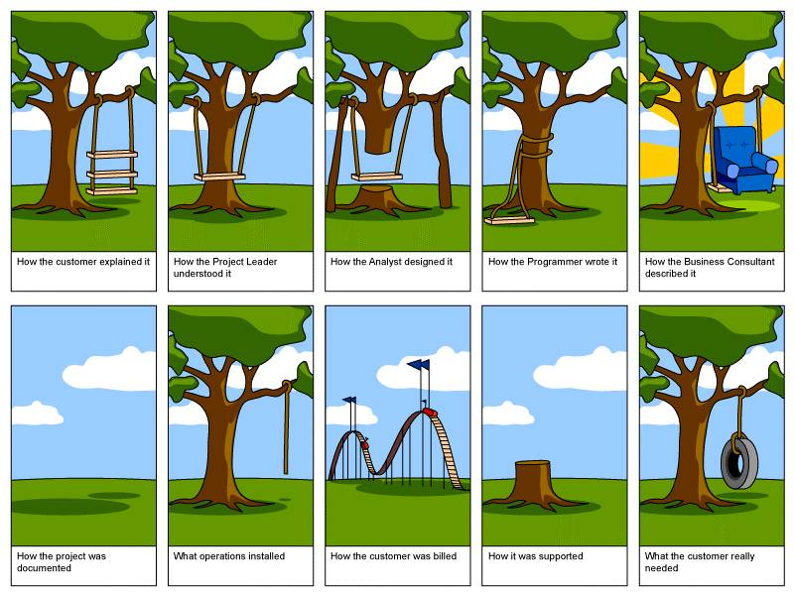

Slide 10
What Is Software ?
Programs
Source code
Data structures
Documents
Requirements and specification documents
Design documents
Test suites and test plans

Slide 11
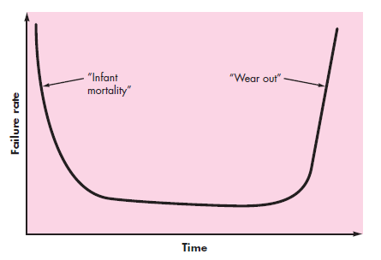
Hardware Failure Curve
‹#›

Slide 12
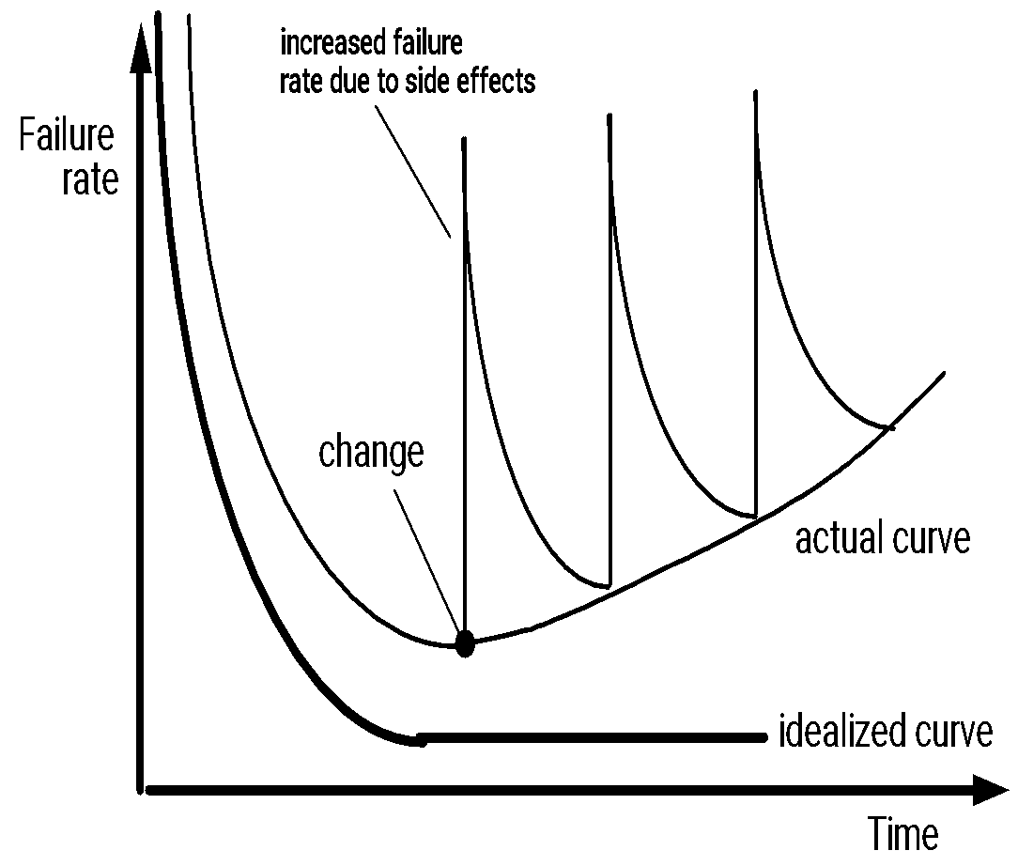
Software failures
‹#›
Notes:
‹#›

Slide 13
What Is Good Software?
Correct, correct, correct
Maintainable and easy to modify
Well modularized with well-designed interfaces
Reliable and robust
Has a good user interface
Well documented
Internal documentation for maintenance and modification
External documentation for end users
Efficient
Not wasteful of system resources, cpu & memory
Optimized data structures and algorithms

Slide 14
Goodness Goals Conflict
All goodness attributes cost $s to achieve
Interaction between attributes
High efficiency may degrade maintainability, reliability
More complex user interface may degrade efficiency, maintainability, and reliability
Better documentation may divert effort from efficiency and reliability
Software engineering management has to trade-off satisfying goodness goals

Slide 15
Legacy Software
Why must it change?
software must be adapted to meet the needs of new computing environments or technology.
software must be enhanced to implement new business requirements.
software must be extended to make it interoperable with other more modern systems or databases.
software must be re-architected to make it viable within a network environment.
‹#›
Notes:
‹#›

Slide 16
Software Myths
Management myths
We already have a book that’s full of standards and procedures for building software. Won’t that provide my people with everything they need to know.
My people do have state-of-the-art software development tools
If we get behind schedule, we can add more programmers and catch up – Mongolian Horde Concept

Slide 17
Software Myths…
Customer myths
A general statement of objectives is sufficient to begin writing programs…we can fill in the details later.
Project requirement continually change, but change can be easily accommodated because software is flexible.

Slide 18
Software Myths…
Developer myths
Once we write the program and get it to work, our job is done.
Until I get the program “running” I really have no way of assessing its quality.
The only deliverable for a successful project is a working program.

Slide 19
Need Different Approaches for Developing Large Software
Need formal management of software production process.
Formal & detailed statement of requirements, specification and design.
Much more attention to modularity and interfaces.
Must be separable into manageable pieces.
Need version control.
More emphasis of rigorous and thorough testing.
Need to plan for long term maintenance and modification.
Need much more documentation, internal and external.

Slide 20
Why Is Software Development Hard?
Changing requirements and specifications
Inability to develop complete and correct requirements
Programmer variability and unpredictability
Communication and coordination
Imprecise and incomplete requirements and specifications
Inadequate software development tools
Inability to accurately estimate effort or time required
Overwhelming complexity of large systems, more than linear growth in complexity with size of the system
Poor software development processes
Lack of attention to issues of software architecture

Slide 21
What is Software Engineering?
The science ( & art) of building high quality software systems
On time
On budget
With correct operation
With acceptable performance
Software Engineering:
The application of a systematic, disciplined, quantifiable approach to the development, operation, and maintenance of Software

Slide 22
SE Framework Activities
Communication
Requirement collection
Planning
Specification
Modeling
Requirement Analysis
Design
Construction
Code generation
Testing
Deployment
Release
Maintenance
‹#›

Slide 23
Major Software Production Tasks
Requirements analysis:
Analyze software system requirements in detail
Specification:
Develop a detailed specification for the software
Design:
Develop detailed design for the software data structures, software architecture procedural detail, interfaces
Coding:
Transform design into one or more programming language(s)
Testing:
Test internal operation of the system and externally visible operations & performance
Release:
Package and deliver software to users
Maintenance:
Error correction and enhancement after system

Slide 24
The Essence of Practice
Polya suggests:
1. Understand the problem (communication and analysis).
2. Plan a solution (modeling and software design).
3. Carry out the plan (code generation).
4. Examine the result for accuracy (testing and quality assurance).
‹#›

Slide 25
Understand the Problem
Who has a stake in the solution to the problem? That is, who are the stakeholders?
What are the unknowns? What data, functions, and features are required to properly solve the problem?
Can the problem be compartmentalized? Is it possible to represent smaller problems that may be easier to understand?
Can the problem be represented graphically? Can an analysis model be created?
‹#›

Slide 26
Plan the Solution
Have you seen similar problems before? Are there patterns that are recognizable in a potential solution? Is there existing software that implements the data, functions, and features that are required?
Has a similar problem been solved? If so, are elements of the solution reusable?
Can subproblems be defined? If so, are solutions readily apparent for the subproblems?
Can you represent a solution in a manner that leads to effective implementation? Can a design model be created?
‹#›

Slide 27
Carry Out the Plan
Does the solution conform to the plan? Is source code traceable to the design model?
Is each component part of the solution provably correct? Has the design and code been reviewed, or better, have correctness proofs been applied to algorithm?
‹#›

Slide 28
Examine the Result
Is it possible to test each component part of the solution? Has a reasonable testing strategy been implemented?
Does the solution produce results that conform to the data, functions, and features that are required? Has the software been validated against all stakeholder requirements?
‹#›

